Slide 1
Improving Fetal Health Outcomes by combining Cardiotocograms and Data Science Predictions
How can we use machine learning to enhance clinical decisions and increase viability
Notes:
My background: Clinical background in Pediatrics and Maternal Fetal Care. Full Spectrum Doula , that is a person who provides direct support to the birthing person in prenatal, active childbirth, postpartum, pregnancy loss and termination. Perinatal is a commonly used term, that you will hear during this presentation, refers to the entire arc of birthing process. As a music therapist, integrated mental health care and biopsychosocial music-based interventions to support clinical goals while inpatient.
Major question entering this course. How can Data Science improve access and efficacy of perinatal care delivery and patient outcomes?
In line with that question, I chose a fetal health data set from Kaggle
Primary aim: orienting this presentation as argument for Hospital X / OBGYN / MaternalFetal Care departments to integerate the use of Cardiotocogram + implementing a machine learning predictive model to inform clinical decisions/ improve overall health outcomes for neonates and the birthing person.

Slide 2
Rationale
Reduction of child mortality is a key indicator of human progress
Global goal to end preventable deaths of newborns and children under 5 years. At least as low as 25 per 1000 births by 2030 (UN)
Decreasing maternal mortality rate, which is currently highest in OECD 26.4 per 100,000 births in the US. The vast majority of these deaths (94%) occurred in low-resource settings, and most could have been prevented.
“Cardiotocograms (CTGs) are a simple and cost accessible option to assess fetal health, allowing healthcare professionals to take action in order to prevent child and maternal mortality. The equipment itself works by sending ultrasound pulses and reading its response, thus shedding light on fetal heart rate (FHR), fetal movements, uterine contractions and more.”
Ayres de Campos et al. (2000) SisPorto 2.0 A Program for Automated Analysis of Cardiotocograms. J Matern Fetal Med 5:311-318
Notes:
The data set that I used was located on Kaggle and is part of a research study conducted in Portugal by
Diogo Ayres de Campos university of Lisboa
Joao Bernardes University of Porto
Who were interested in creating a program for automated analysis of CTG’s to be implemented in Maternal Fetal Health Care Services.
The maternal mortality rate in the United States is three times higher than that in neighboring Canada and six times higher than in Scandinavia.
Black women are twice as likely to die in childbirth (42 per 100k) , so enhanced perinatal health services can have a significant impact on underreousrced communities. Social justice / access
Im sure it seems very clear to you ‘why’ we must improve maternal fetal health care - but you might be wondering what exactly is cardiotography and how is a cardiotocogram administered?

Slide 3

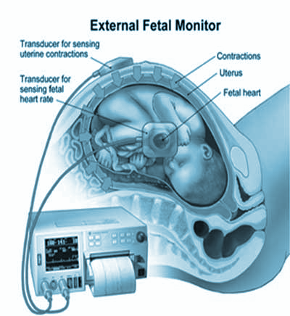
Cardiotocograph
(CTGs)
Notes:
Widely used and available device for cardiotography.
Often referred to as a fetal heart monitor or doppler, using an ultrasound transducer to capture the fetal heart rate in presence or absence of uterine contractions.
For a long time, expert obstetricians have been utilizing the cardiotocographic information to inform their clinical decisions and analyse the fetal health status.
Now Let’s talk about fetal health data and how predictive modeling can potentially improve our clinical approach to fetal health in a cost effective way.

Slide 4
Variables
Accelerations
Fetal Movement
Fetal Heart Rate
Uterine Contractions
Decelerations
Fetal Health
Baseline
Per second
Per second
Per second
Light,
Severe,
Prolongued
Normal,
Suspect,
Pathological

Slide 5
Data Science Process
PHASE 1
PHASE 2
PHASE 3
PHASE 4
Data Cleaning
Exploratory Data Analysis
Preprocessing
Machine Learning

Slide 6
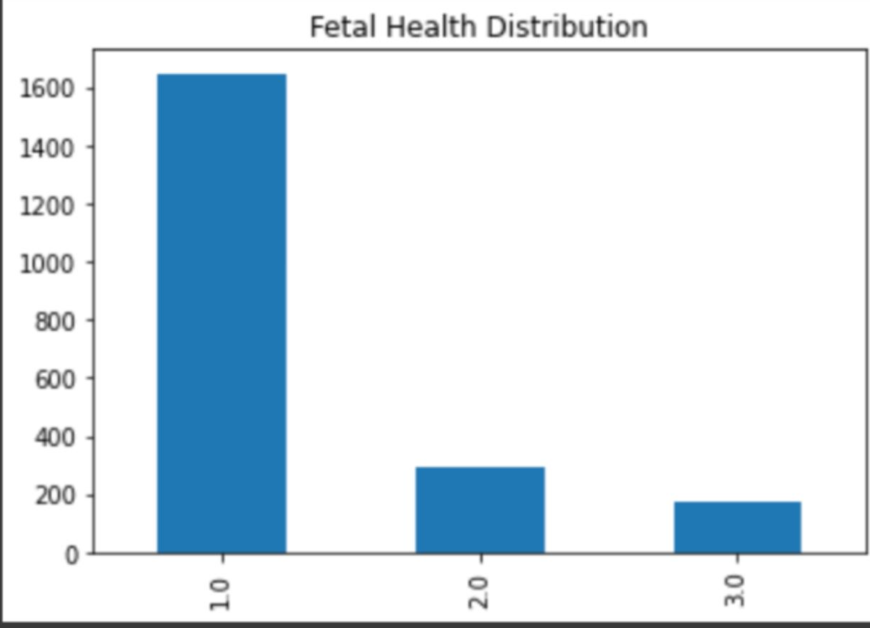
Visualizing
Fetal Health Distribution
in this dataset:
Notes:
1 NORMAL 1646
2 SUSPECT 292
3 PATHOLOGICAL 175

Slide 7
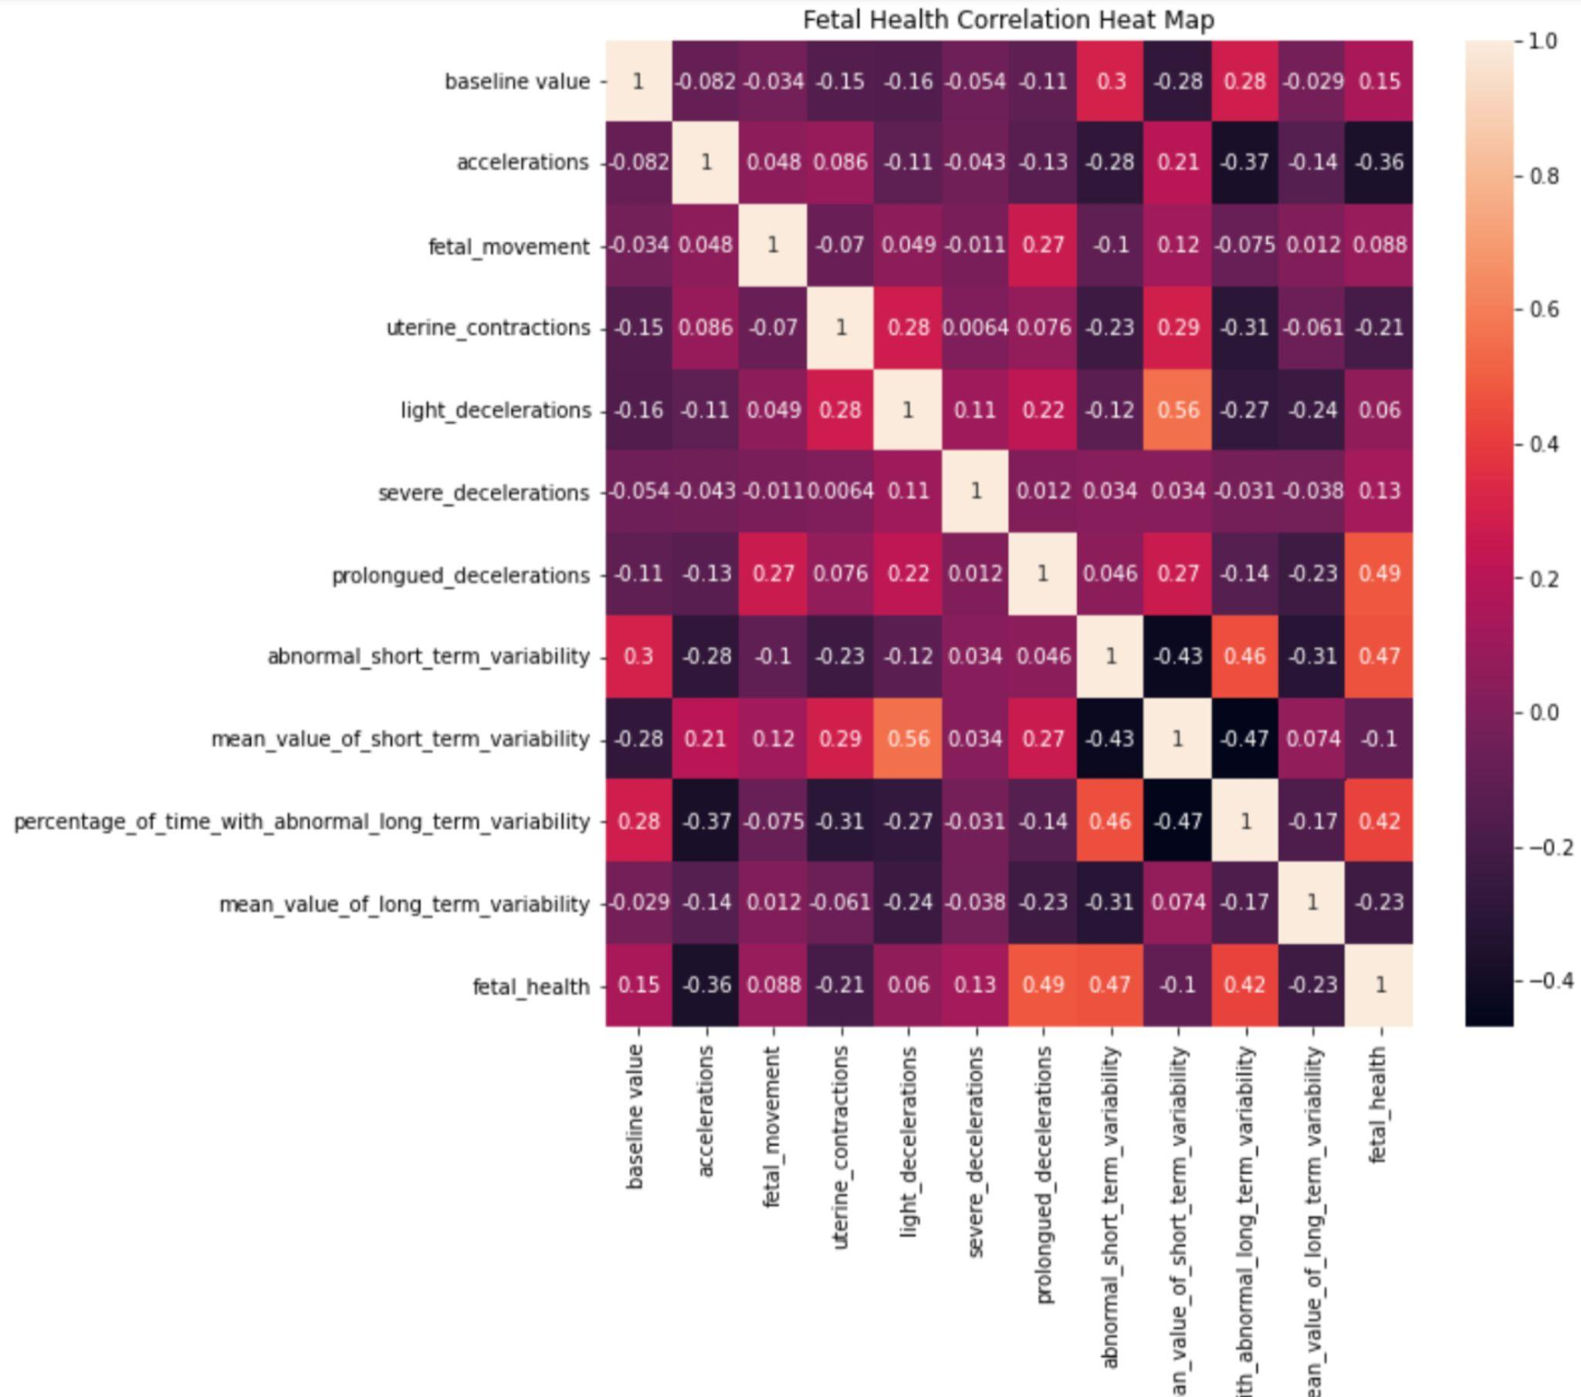
Visualizing correlations of Fetal Health Data and emerging
Fetal Health Predictors
Notes:
Through exploratory data analysis techniques, it was clear that there were correlations of poor fetal health outcomes with heart rate accelerations/ and prolonged decelerations. This follows current prognostic trends in OBGYN medicine. So this data seemed like a good candidate for predictive modeling.
Baseline Fetal Heart Rate (FHR)
Number of accelerations per second
Number of fetal movements per second Number of uterine contractions per second
Number of LDs per second
Number of SDs per second
Number of PDs per second
Percentage of time with abnormal short term variability
Mean value of short term variability
Percentage of time with abnormal long term variability
Fetal Health - 1normal, 2suspect, 3pathological

Slide 8
Machine Learning Trials
Light Gradient Boosting Model
01
02
K Nearest Neighbors Classifier
03
Random Forest Classifier
81% Validity
76% Validity
82% Validity
Notes:
This was a classification problem, because the aim is to predict the poor fetal health outcomes (suspect and pathological) so as to improve OBGYN diagnostic process and more efficiently attend to high risk pregnancies and birth outcomes.
Evaluation metrics included the mean absolute error, mse, rmse, r2 and accuracy

Slide 9
Recommendations
01
02
03
Implement in Health Care Network
Improved Machine Learning Algorithm
Develop Automated Analysis
Program
Notes:
With more dedicated time

Slide 10
Thank you!
Email questions:
eva.vukich@gmail.com

